Slide 1
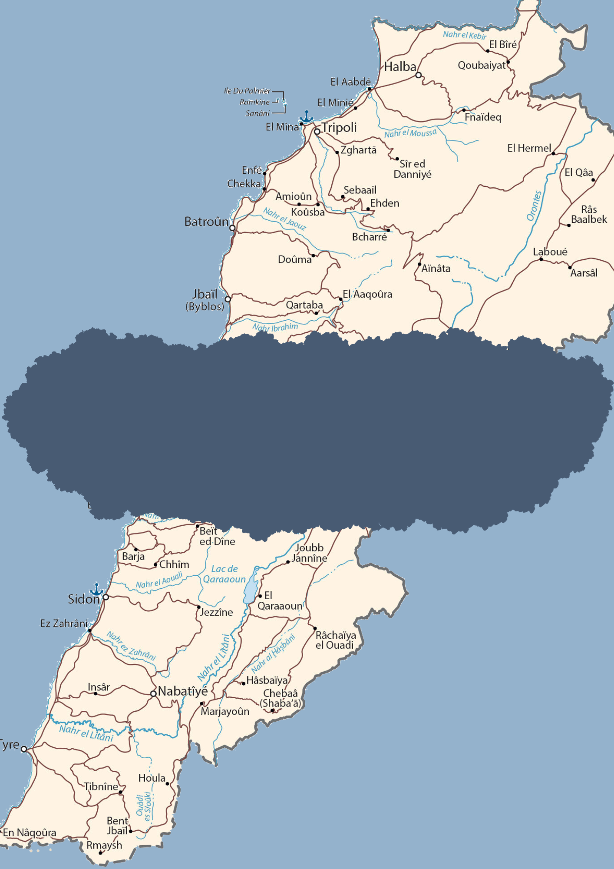
HUMAN RIGHTS DEVELOPMENTS IN A WEEK
12 May - 18 May 2025
SOURCE: LEBANON MAP

Slide 2
Human Rights are inherent to all human beings, regardless of the nationality, place of residence, sex, national or ethnic origin, color, religion, language or any other status without discrimination. These rights are all universal, inalienable, interrelated, interdependent and indivisible.
The articles shared in this brief are the liability of their respective news outlets and do not reflect the views of CLDH.
LEBANON
Injuries in Akkar and Tripoli amidst bullets post municipal elections results
A child was shot in Akkar and is in a critical condition following the announcement of municipal election results and random bullet firing on Monday, May 12.
LBCI correspondent Nada Andraos Aziz was also injured in the leg while covering the elections in Tripoli, and the Ministry of Interior confirmed that 34 people have been arrested since Sunday night.
Excavation work by Israeli bulldozers in Alma Al-Shaab
Two Merkava tanks, two bulldozers, and five Israeli military vehicles entered the Lahlah area in the outskirts of Alma al-Shaab in the Tyre district, and the bulldozers were excavating and constructing earthworks opposite a Lebanese Army checkpoint on Monday, May 12.
Sirens at UNIFIL locations in the South amidst Israeli planes
Air raid sirens were heard at UNIFIL positions in Naqoura, Shamaa, and Mansouri, amid intense overflights by Israeli helicopters and airplanes over the western border villages on Monday, May 12.
Lebanese Army arrests 35 citizens for shooting after municipal elections in North Lebanon and Akkar
Statement issued by The Army Command - Directorate of Orientation on Monday, May 12:
On the evening of May 11, 2025, individuals opened fire upon the announcement of the results of the municipal and mayoral elections in the North Lebanon and Akkar governorates, resulting in civilian casualties. Subsequently, Army units, each supported by a patrol from the Intelligence Directorate, conducted raids and arrested 35 individuals who had fired the shots in various areas of the two governorates. Weapons and ammunition were seized in their possession.
The seized items were handed over, and investigations with the detainees were initiated under the supervision of the competent judiciary. Efforts are underway to arrest the remaining shooters.
Monday
12 May 2025

Slide 3
Israeli airstrike on Houla kills one citizen
An Israeli airstrike attacked a motorcycle and killed one citizen in Houla on Tuesday, May 13, according to the Public Health Emergency Operations Center.
Another airstrike targeted a “Rapid” car with a missile that did not explode in Shaqra, and the driver was not injured.
Israeli forces advance towards the south
Israeli forces advanced towards the Majidiyeh plain and carried out mock raids at low altitude over the Zahrani on Tuesday, May 13, and used heavy fire to comb forests of Aita al-Shaab and Rmeish according to the National News Agency.
Ministry of Culture halts illegal work on the Shawakir Project in Tyre
The Green Southerners Association was notified on Tuesday, May 13, that the Ministry of Culture decided to halt work on the project in the Shawakir area near the Tyre Nature Reserve.
According to the association, “the Ministry of Culture notified the Ministry of Defense of a copy of the decision to halt work, and that the Ministry of Defense will provide its response within days."
One citizen killed in Israeli airstrike on Qaqaiyat al-Jisr
An Israeli airstrike that targeted a car in the town of Qaqaiyat al-Jisr in Nabatieh district killed a citizen on Wednesday, May 14, according to the Public Health Emergency Operations Center.
Earlier the same morning, an Israeli drone crashed and exploded in an empty house and damaged it in Shebaa, Hasbaya District, with no casualties recorded.
North Governor fired amidst municipal election violations
The Lebanese cabinet decided to dismiss Governor of the North district Ramzi Nohra and place him at the disposal of the Minister of Interior Ahmad Hajjar on Wednesday, May 14.
This decision followed the violations of the vote counting process after the municipal elections in Tripoli last Sunday, and the demands of the Lebanese Association for Democratic Elections (LADE) to re-hold elections in Tripoli.
One citizen killed and another wounded in Israeli airstrike on Arnoun
An Israeli guided strike on a bulldozer killed one citizen and injured another in a plain area between Yahmor al-Shaqif and Arnoun on Thursday, May 15.
Israeli plans target prefabricated rooms and drops soudbombs
Israeli artillery targeted a prefabricated room in Adaisseh at dawn and attacked prefabricated rooms in Aita al-Shaab twice in less than half an hour on the night of Thursday, May 15.
Soundboms were also dropped over a house in KfarKila and a destroyed school in Dahra, and more artillery targeted Jabal al-Sadana, Shebaa with eight shells.
Tuesday
13 May 2025
Wednesday
14 May 2025
Thursday
15 May 2025

Slide 4
Parliament passes draft law for random bullet firing
After the recent events of random bullet firing after the municipal elections that threatened the lives of many citizens, the Lebanese parliament passed in its session a draft law that doubles the penalties for firing bullets in the air on Thursday, May 15.
The previous law would rule for imprisonment between 3 months and 3 years for random shooting, and it now provides imprisonment between 6 months and 6 years.
Prisoners in Roumieh Prison riot for the execution of General Amnesty Law
Prisoners protested in Roumieh prison and unrest erupted, coinciding with a parliamentary session to pressure voting on the general amnesty law on Friday, May 16.
Some of the prisoners hug nooses in the prisoners and threatened to commit suicide, while families of the inmates also gathered outside the prison demanding to pass the bill, which was ultimately not voted upon.
Clashes between Al-Jumaijmeh residents and UNIFIL patrol
After a UNIFIL patrol entered a private property in the town of Al-Jumaijmeh, Bint Jbeil district, a clash broke out between the residents and the soldiers on the morning of Friday, May 16.
The residents and landowners of the property intercepted the patrol as it was not escorted by the Lebanese army. As a response, UNIFIL soldiers fired in the air and threw tear gas to disperse the crowd and injuries on both sides were recorded.
Israeli phosphorus shelling and drone crashing in the South
An Israeli phosphorus shell fell on the town of Adaisseh on Friday, May 16, , according to the Lebanese Army, and another Israeli drone crashed in the Alman al-Shomriya area of ​​Marjeyoun.
Israeli airstrikes on cars and prefabricated rooms and soundbombs in the South
In the morning of Saturday, May 17, Israeli airstrikes targeted a car in Wadi Khalil and a hangar in Aita al-Shaab with no injuries recorded.
A prefabricated room and a stone-making factory were attacked in the Yarin border area. A soundbomb was dropped over fishermen on the Naqoura coast, and three others targeted a destroyed house in Kfarkila.
Israeli airstrike targets a car and injures two citizens in Beit Yahoun
One army soldier and one citizen were injured in an Israeli airstrike on a Rapid car on the main road in Beit Yahoun near an army checkpoint on Sunday, May 18.
Another Rapid car was attacked with Israeli gunfire in Kfarkila, while Israeli forces dropped flares over the Shebaa Farms and conducted combing operations near Al Jidar area.
.
Friday
16 May 2025
Saturday and Sunday
17 and 18 May
2025

Slide 5
REPORTING A VIOLATION OF HUMAN RIGHTS TO CLDH
If you wish to report an incident that may potentially constitute a violation of human rights, kindly send an email to the following address: violations@cldh-lebanon.org
You can also report an incident anonymously through our website.
When making a report, please ensure to include the following information:
WHERE: City/village, governorate, additional details (e.g. what prison)
WHAT: Nature of the violation
HOW: A narrative description of what happened
WHEN: Date of the episode (at least the year, if day and month are unknown)
TO WHOM: Information regarding the victim (name, nationality, gender, date of birth, city of origin, phone number). Only share this information with the consent of the person.
WHO is the person reporting (name, phone number) and how were they identified (e.g., victim him/herself, family member, eyewitness, journalist, humanitarian worker...)
The information referred will remain completely private. It will be fact-checked and registered into CLDH’s internal system. No action will be undertaken without the explicit and written consent of the reporter.
FUNDED BY THE UNITED NATIONS DEMOCRACY FUND

